Slide 1
Programming Artificially Intelligent Apps
Hy-Tech Camp

Slide 2
Agenda
Icebreaker
Presentation
Blooket
Follow-Along Activity
Challenges

Slide 3
Icebreaker

Slide 4


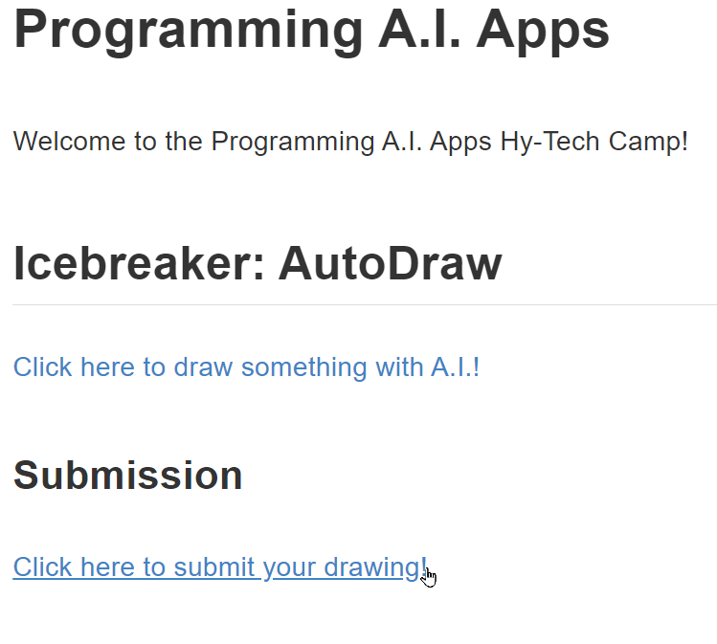

Icebreaker
bit.ly/hytechcamps
Programming Artificially Intelligent Apps
Open AutoDraw
Draw something
Copy drawing link
Submit drawing

Slide 5
Presentation

Slide 6
Presentation Topics
Perceptions of A.I.
History of A.I.
Machine Learning

Slide 7
Where have you seen artificial intelligence?

Slide 8
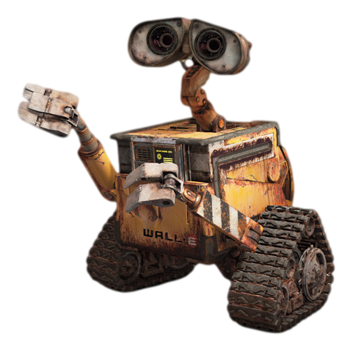
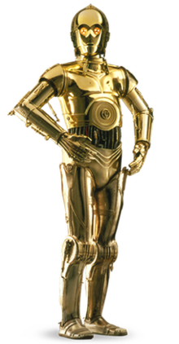

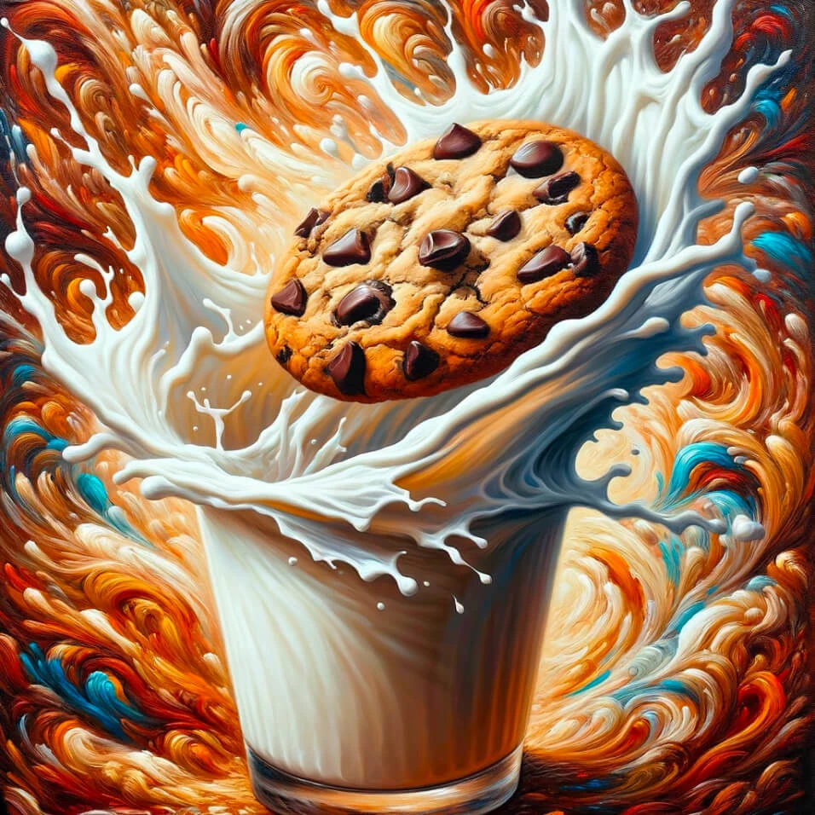




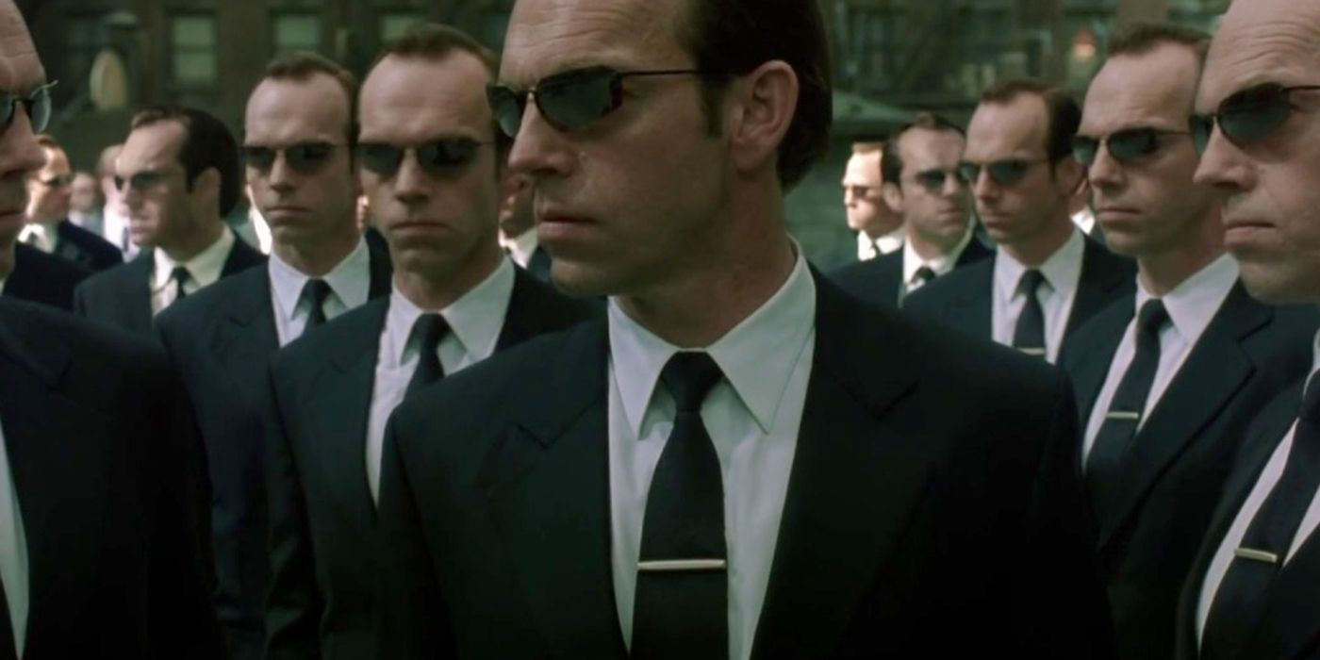
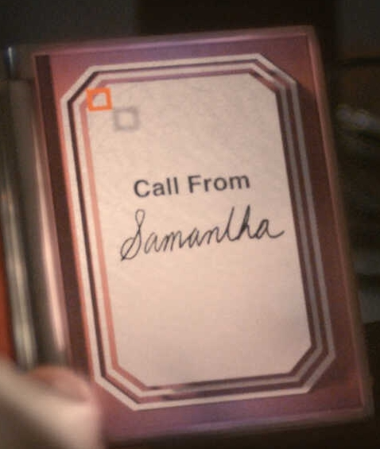
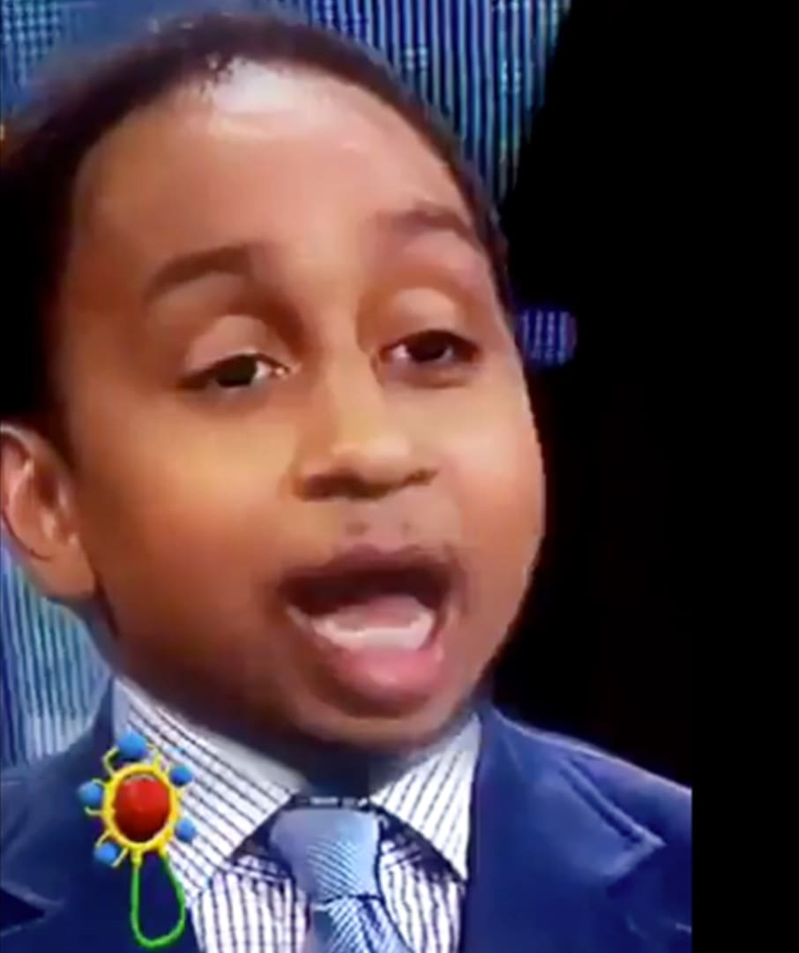
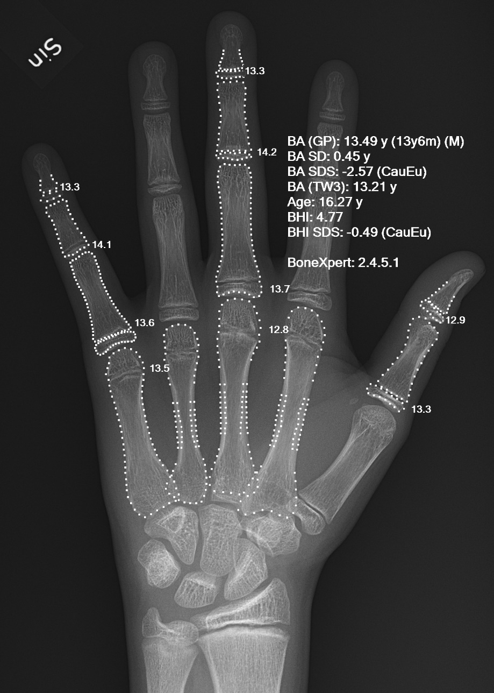
Fiction
Non-Fiction
Notes:
Fictional Examples (clockwise from top left): HAL 9000 from 2001: A Space Odyssey, WALL-E, C-3PO from Star Wars, Samantha from her, Agent Smith from The Matrix, JARVIS from Marvel
Real World (clockwise from top left): ChatGPT using an LLM for text, DALL-E 3 for image generation, Alexa and Smart Speakers, Medical diagnosis, Snapchat/TikTok filters, Game A.I.

Slide 9
A.I. & Society
Raise your hand if you’ve used ChatGPT or another chatbot.
What are some benefits to these A.I. tools?
What are some potential risks?
Educational – e.g., explaining code for you
Creative – e.g., generating ideas for you
Supportive – e.g., completing simple tasks for you
Creative – e.g., taking away artistic work from humans
Informative – e.g., providing information that is incorrect or misleading
Existential – e.g., creating a superintelligence that destroys humanity
Notes:
Pose these questions to the students. Hopefully, they will have enough interest to shape the discussion around these things.
Reveal some of the potential answers, and feel free to discuss further if there is interest.

Slide 10
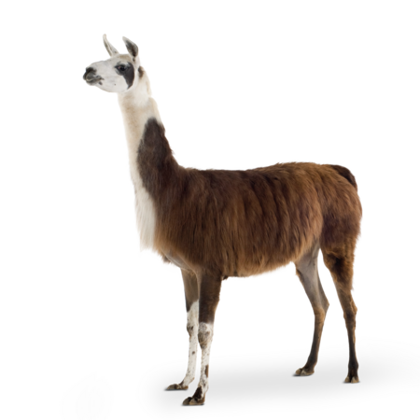

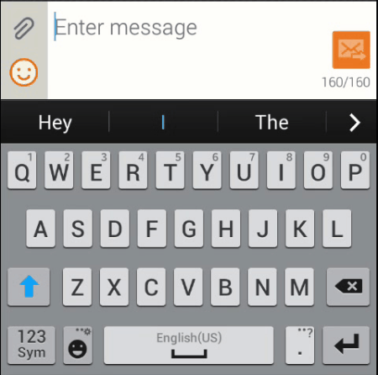
ChatGPT & LLMs
Large Language Models are the powerful text-generating neural networks behind a lot of language-based A.I.
GPT-3.5 and GPT-4 are the LLMs that power ChatGPT
LLMs are trained on gigantic bodies of text from various sources, and pull from that data to predict what text should come next in a sequence – like predictive text on a phone

Slide 11
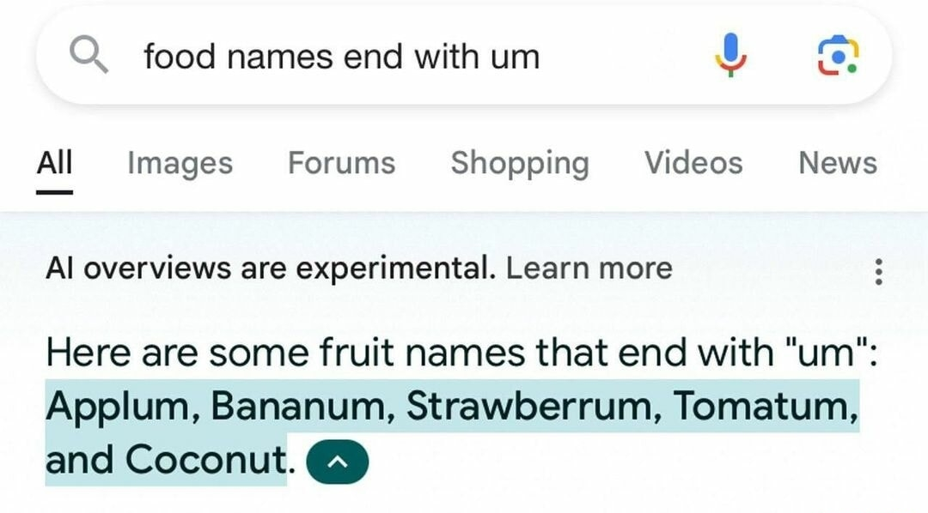
A.I. isn’t perfect
Notes:
Here is one funny example of A.I. miserably failing to name fruits

Slide 12
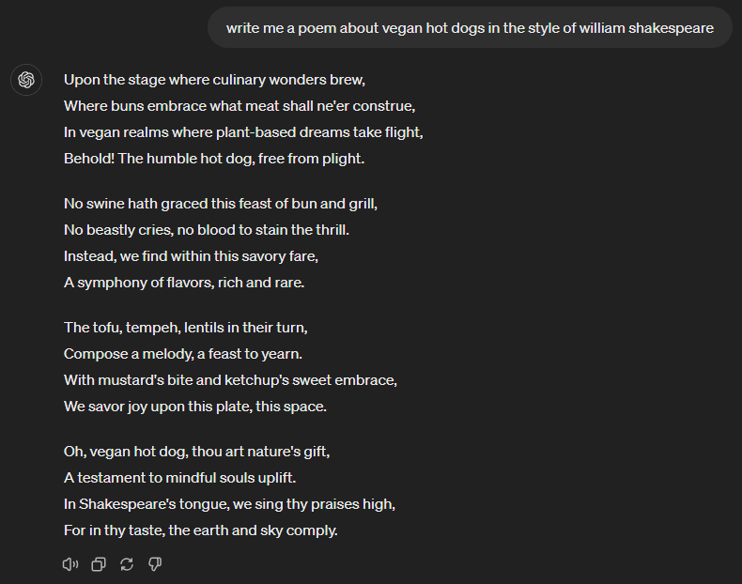
A.I. is very good at some things
Deterministic Tasks
Asking Alexa to start a timer for 10 minutes
Supporting Human Work
Not replacing, but aiding in things like brainstorming, basic content generation, and job assistance
Matching Writing Styles
Writing like Shakespeare
A.I. is ever-evolving (and may someday fuel its own evolution)
Notes:
A.I. is very good at some things.
Deterministic tasks are things that have clear end goals – like setting a timer. A.I. can do these things because it learned directly.
A.I. has also gotten very good at matching writing styles, or copying from massive data sources. For example, you can bring Shakespeare back from the dead and get him to write a poem about anything you’d like.
Overall, A.I. is very good at supporting the work of humans. Job replacement for knowledge workers may be in the future, but at this point, A.I. is just a helpful tool.
One note is that A.I. continues to evolve more and more. And one day… it may be able to evolve itself by itself. Which is scary but cool.

Slide 13
History of A.I.
How did we get here?
Notes:
But before we get too far, let’s take a step back. How did we get here?
We’re going to talk a little tiny bit about the history of A.I.

Slide 14
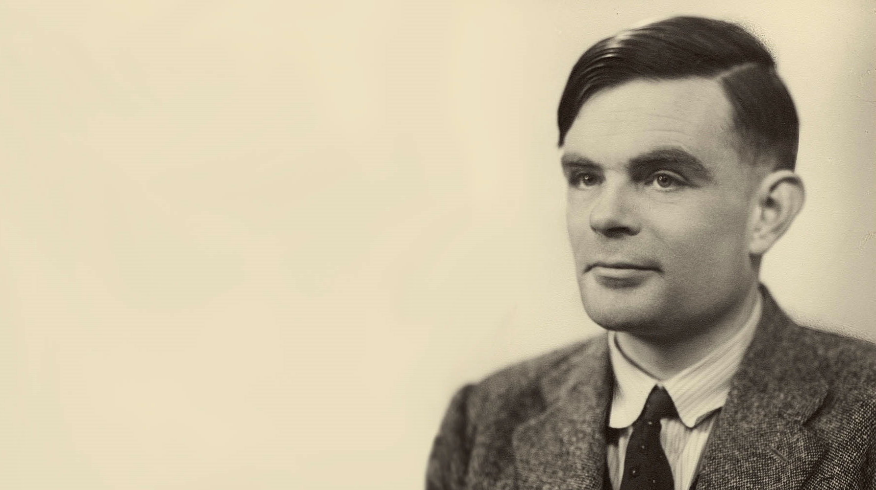
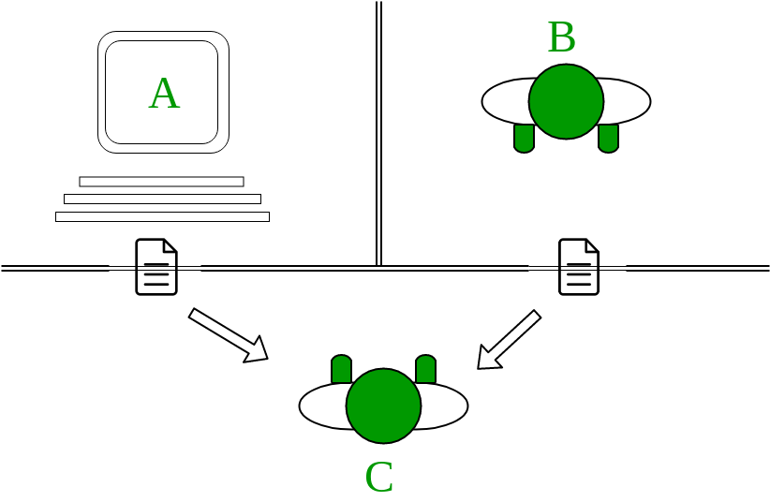
The Turing Test – 1950
Landmark paper in early AI
Conceived by Alan Turing – the father of artificial intelligence
Tests if a machine can “think”
Notes:
In 1950, Alan Turing invented the Turing Test, which was the first serious proposal in the philosophy of artificial intelligence. It essentially turned AI into science.
Alan Turing had numerous other accomplishments prior to the Turing Test. He was a WWII code-breaker, and created the Turing machine, a model of computation still used today. He liked to name things after himself.
The test was designed to analyze the ability of a machine to “think.” Because the definition of “thinking” is so imprecise, Turing proposed that a different definition be used: the machine should appear to think as a human does.
How the test works
An interrogator (human) is given the task of determining which player (A or B) is a human. The interrogator can only use written questions and see written responses. If the interrogator is unable to divine which player is the computer, the computer “passes” the test.
Sources
https://plato.stanford.edu/entries/turing-test/#Tur195ImiGam

Slide 15
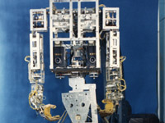
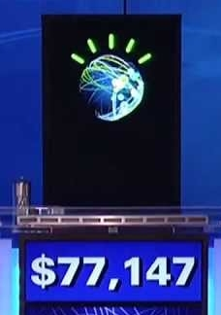

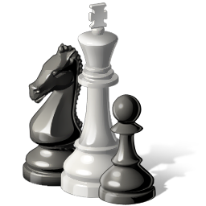
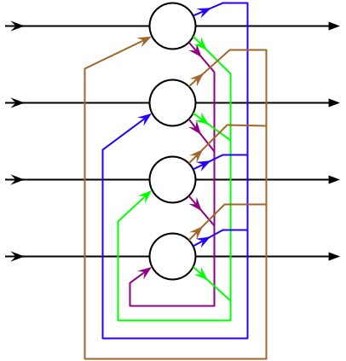
1950
Turing Test
1972
WABOT-1
1st Android
2011
Watson wins Jeopardy!
1987-1993
2nd AI Winter
1956
Dartmouth Conference
Birth of “Artificial Intelligence”
1980
XCON
Expert system
1964
ELIZA
Chatbot
1974-1979
1st AI Winter
1997
Deep Blue defeats Kasparov
1951
Game AI
1968
SHRDLU
Understanding natural language in blocks world
1982
Connectionism Revival
Present
,
LLMs, GenAI
MACHINE LEARNING
Notes:
1950 – Alan Turing created the Turing Test
1951 – Developers worked on machines that could play Chess and Checkers
1956 – The Dartmouth Conference coined the term “Artificial Intelligence”
1964 – ELIZA (one of the first chat bots) is created
1968 – SHRDLU is created. It allowed users to speak with a program to move blocks in a virtual world (called “blocks world”).
1972 – WABOT-1 (the first full-scale humanoid robot) is created.
1974-1979 – The first AI winter, funding went away because the promises of AI did not seem achievable
1980 – XCON (an expert system) saves the Digital Equipment Corporation several millions of dollars. Expert systems made AI useful.
1982 – Connectionism used artificial neural networks, which would eventually drive programs like optical character recognition and speech recognition
1987-1993 – A second AI winter caused by an economic bubble bursting
1997 – Deep Blue (a chess playing computer) defeats Garry Kasparov, the reigning world champion. This was a testament to the speed of modern computers
Between 1997 and 2011, AI is used behind-the-scenes for all sorts of applications like data mining, medical diagnosis, and Google’s search engine
2011 – IBM’s Watson wins Jeopardy. Computers keep getting faster
In the present, AI is used for deep learning, big data, and something called “Generative AI” which generates content.
Chatbots have come a long way, thanks largely to LLMs. And these LLMs are powered by…
Sources
https://plato.stanford.edu/entries/turing-test/#Tur195ImiGam

Slide 16
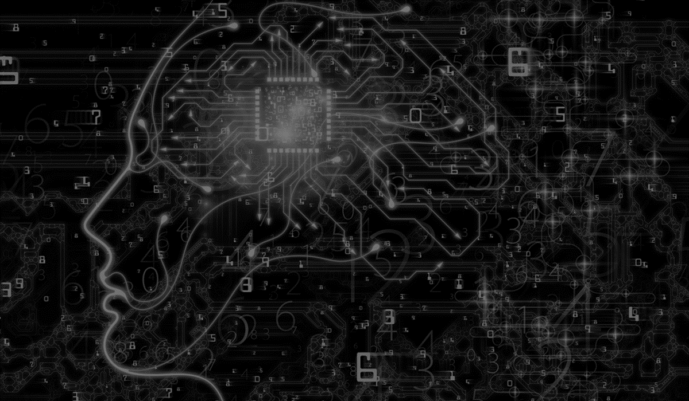
MACHINE LEARNING
Notes:
One interesting subset of artificial intelligence is Machine Learning.
Ask the students if they can guess what machine learning is.

Slide 17
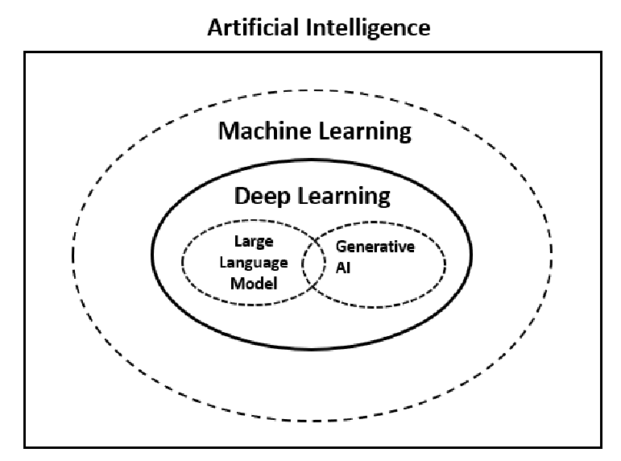
How does machine learning fit into A.I.?
Notes:
Show that machine learning is a subset of A.I.

Slide 18
What do machine learning algorithms do?
Machine-learning algorithms find and apply patterns in data.
Other algorithms take in an input and use a set of rules to determine the output
Machine-learning algorithms take in a bunch of data and find the model that matches the data
x = 5,
y = 25
5 → → 25
9 → → 81
square algorithm
Model
ML algorithm
y = x²
square algorithm
x = 9,
y = 81
Notes:
Explain that machine learning algorithms take in a bunch of data, and then find and apply patterns from the data.
Non-ML algorithms will take in an input, do something to it, and provide the output. An example of one of these algorithms is the squaring algorithm. Ask the students if they know what the squaring algorithm is: it is simply the input multiplied by itself.
On the other hand, machine learning algorithms take in a bunch of data and figure out the rules that determine the relationship between the data. For example, given a set of (x, y) pairs, the machine learning algorithm can determine that the relationship between them is the square algorithm.
In the real world, machine learning algorithms are useful when the rules of a problem are unknown. Tasks that involve following rules which can be worked out are not a good use for machine learning. For example, it would not make sense to use a machine learning approach to calculate the tax on a restaurant bill; no learning is necessary for that.
--Sources
https://www.technologyreview.com/2018/11/17/103781/what-is-machine-learning-we-drew-you-another-flowchart/
https://towardsdatascience.com/machine-learning-an-introduction-23b84d51e6d0
https://github.com/IBM/taxinomitis/blob/master/public/languages/en.json

Slide 19
When should machine learning be used?
Machine learning provides solutions to complex problems that do NOT have clear, deterministic rules
ML Solution
Pattern recognition
Image classification
Working with unstructured data
Working on problems with ambiguity
I need to translate auditory speech into text
I need to teach a car how to drive itself
I need to recommend movies based on watch history
Non-ML Solution
“Solved” problems
Calculations with clear formulas
Working with structured data
Working on problems with limited input
I need to convert the temperature to Celsius
I need to filter student data by grade level
I need to find how many times a certain word appears in a block of text
Notes:
Machine learning is useful in many circumstances, but in some cases, it would not be worth using.
It is really used for complex problems that do not have clear, deterministic rules.
Let’s look at some features of ML problems,
As well as Non-ML problems.
ML is really good at things like pattern recognition, image classification, working with unstructured data, and working with ambiguity.
Non-ML would be better for problems that have already been “solved” (like Tic Tac Toe), calculations, structured data work, and problems with a set input.
Here are some examples of problems that could be solved by ML.
Here are some examples of problems that could be solved without the use of ML.

Slide 20
How are machine learning models built?
1: Data Collection and Preparation
Developers prepare the dataset with example data. These data points should have features relevant to the problem.
2: Training
The algorithm learns from the examples in the dataset to build a model. A model is a representation of the pattern the algorithm has learned.
3: Evaluation and Tuning
Developers test the model and re-train with more data if necessary.
Notes:
Go over the (simplified) steps a machine learning algorithm takes.
Emphasize the importance of data collection and preparation – this is often the most expensive part of the process.
Note that developers should find as many examples as possible, but it is important to stay practical! It does not make sense to take months building an enormous dataset when a smaller one might do just as well.
The training phase is where the actual model is built – this is where the machine learns.
Iteration is just adjusting the model if it does not perform well enough.
After these steps, the machine learning model should be ready for application!
--Sources
https://towardsdatascience.com/machine-learning-an-introduction-23b84d51e6d0
https://github.com/IBM/taxinomitis/blob/master/public/languages/en.json

Slide 21
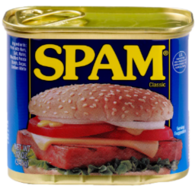
Example: E-mail Spam Filter
E-mail 1
from: scam.biz
msg: Helo, …
E-mail 2
from: gmail.com
msg: Hi Sam, …
E-mail 3
from: yahoo.biz
msg: Hi thre, …
E-mail 49,241
from: mail.com
msg: Hello, …
…
What are the rules for SPAM?
.biz e-mail addresses and misspellings
E-mail 49,242
from: yahoo.com
msg: Good morning, ….
?
Notes:
A spam filter is given a bunch of training data of e-mails that have been labeled “SPAM” or “NOT SPAM”.
Note: in the real world, it is usually necessary to have a LOT of data to properly train an ML algorithm. It is important that the data is all reliable.
Ask the students if they can spot the pattern: spam e-mails are from .biz e-mail addresses, and they have misspellings.
For another example e-mail from yahoo.com saying “Good morning,” is it SPAM or NOT SPAM? It is not spam because it is from a .com e-mail address and there are no misspellings.

Slide 22




Should datasets be varied?
Datasets should be as varied as possible: different types, angles, etc
Dog
Dog
Dog
Not Dog
Machine learning algorithms are only as good as the data they are given – they take on the biases of the data collectors
Notes:
Ask the students if they think data should be varied or not. It should be varied!
Example: say a machine learning algorithm has been trained with a dataset containing three dogs. Specifically, three yellow lab puppies. Given a picture of a Chihuahua, would the model recognize it as a dog? No! It is very important to vary the training data as much as possible, so that it is robust.
Ultimately, machine learning algorithms are only as good as the data they are given. If the data collector or preparer has some bias, that will be present in the machine learning model. It is always important to consider these factors when providing data to an algorithm.
--Sources
https://github.com/IBM/taxinomitis/blob/master/public/languages/en.json
https://freedom-to-tinker.com/2016/08/24/language-necessarily-contains-human-biases-and-so-will-machines-trained-on-language-corpora/

Slide 23
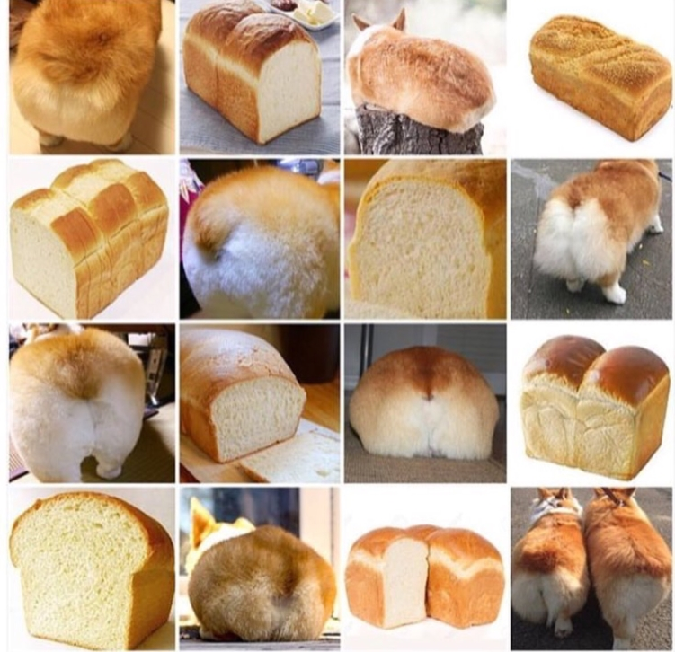
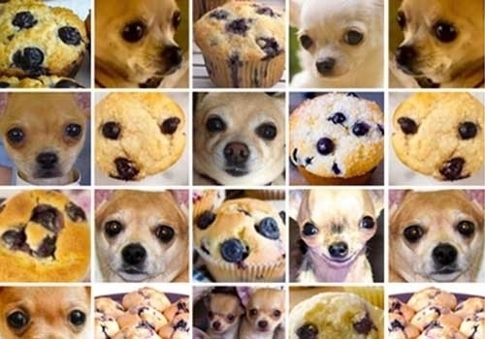
Examples and Counter-Examples
Corgi or Bread?
Chihuahua or Blueberry Muffin?
Notes:
You can also run into more unpredictable issues, like… <click>
Chihuahua vs Blueberry Muffin or… <click>
Corgi vs Bread
It’s always a good idea to provide as many examples and counter-examples as you can in order to avoid any issues!

Slide 24
Approaches
Supervised Learning
Labeled data – input/output pairs
🍌 → Banana
🍉 → Melon
🍌 → Banana
🍎 → Apple
🍈 → Melon
🍍 → Pineapple
🍏 → Apple
🍈 → Melon
Unsupervised Learning
Unlabeled data – knowledge discovery
Input
🍌
🍉
🍌
🍎
🍈
🍍
🍏
🍈
Category
1
2
1
3
4
5
6
4
Category
1
2
1
2
3
1
3
3
fruit
color
Notes:
For Supervised Learning, Labeled data is provided of past input and output pairs during the learning process to teach the model how it should behave. Reliable, unbiased examples are extremely important.
For example, for a fruit classification model, there could be different pictures of fruits that are all properly labeled. The model would then be able to recognize similar types of fruit.
For Unsupervised Learning, Only input data is provided in the examples. There are no labeled example outputs. This method is sometimes called knowledge discovery.
For the same example, there may be many pictures of fruit, but no idea as to which fruit is which. The model could come up with its own way to categorize these fruits.
For example, one category might recognize each individual type on a narrow level – separating red from green apples, and keeping melons separate.
Alternatively, there may be different categories found – in this column, what do these categories mean? The left is fruit, and the right is by color.
--Sources
https://towardsdatascience.com/machine-learning-an-introduction-23b84d51e6d0

Slide 25

Reinforcement Learning
Positive and negative feedback is used to reinforce behaviors
Notes:
Another approach is reinforcement learning. In this approach, positive and negative feedback is used to reinforce behaviors.
Here’s an example of an A.I. learning to play Mario! It takes several tries, but each time through, it learns a little bit more. Whenever Mario dies, the A.I. learns that something went wrong. Whenever Mario makes it farther through the level, the game learns that something went right!
--Sources
https://towardsdatascience.com/machine-learning-an-introduction-23b84d51e6d0

Slide 26
Questions?

Slide 27
Blooket

Slide 28
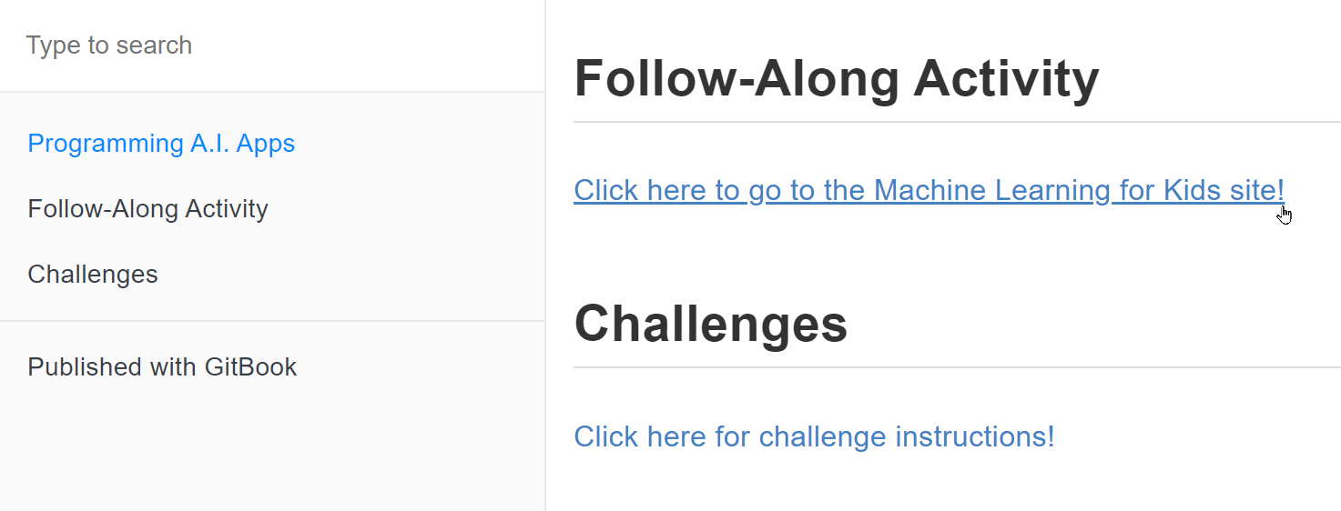
Follow-Along Activity
click the link on the camp homepage
Notes:
Students should go to the camp homepage, and click the link under “Follow-Along Activity”

Slide 29
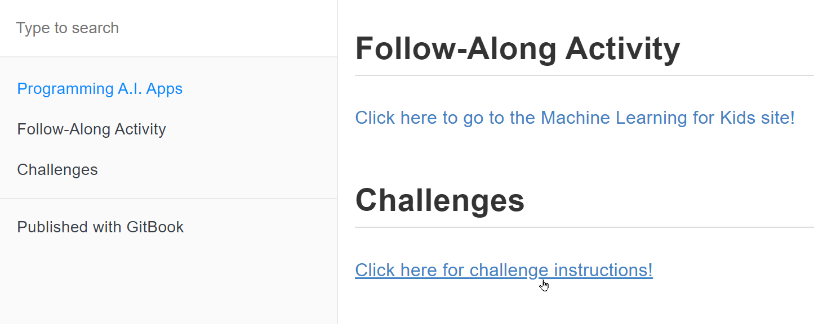
Challenges
click the link on the camp homepage
Notes:
Students should go to the camp homepage, and click the link under “Follow-Along Activity”

Slide 30
Thank You!

